Slide 1
Vision

Slide 2
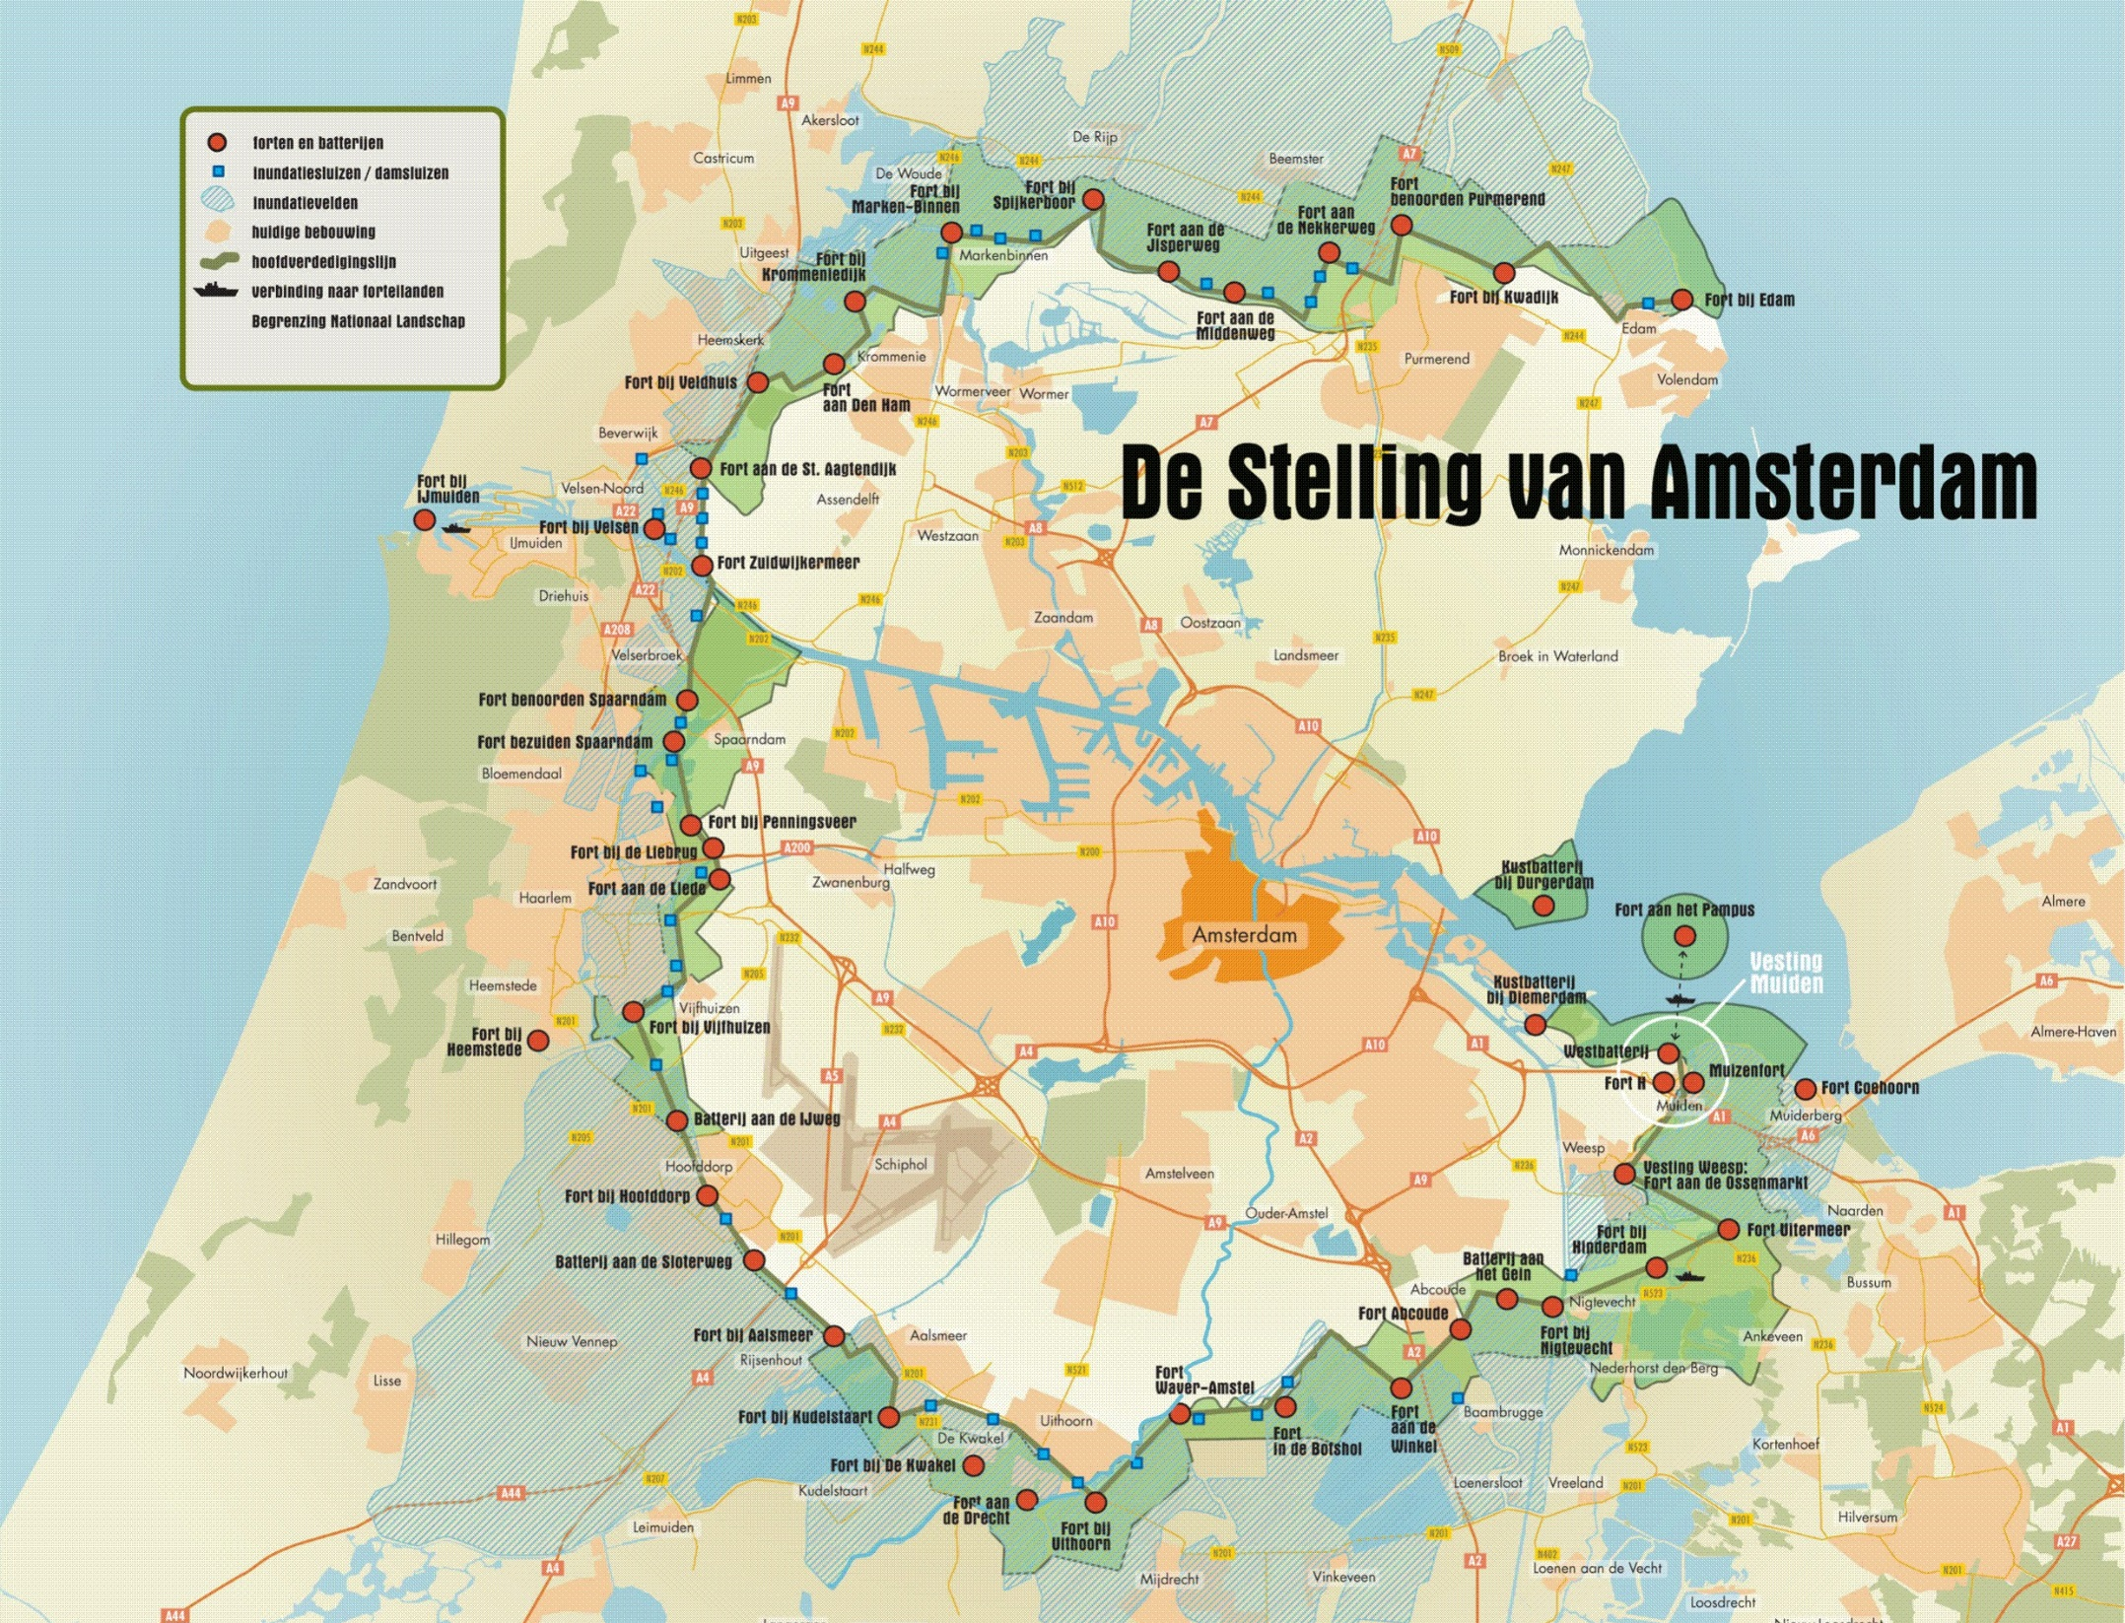

Slide 3
1874
1914
Photos © Kenneth Stamp

Slide 4
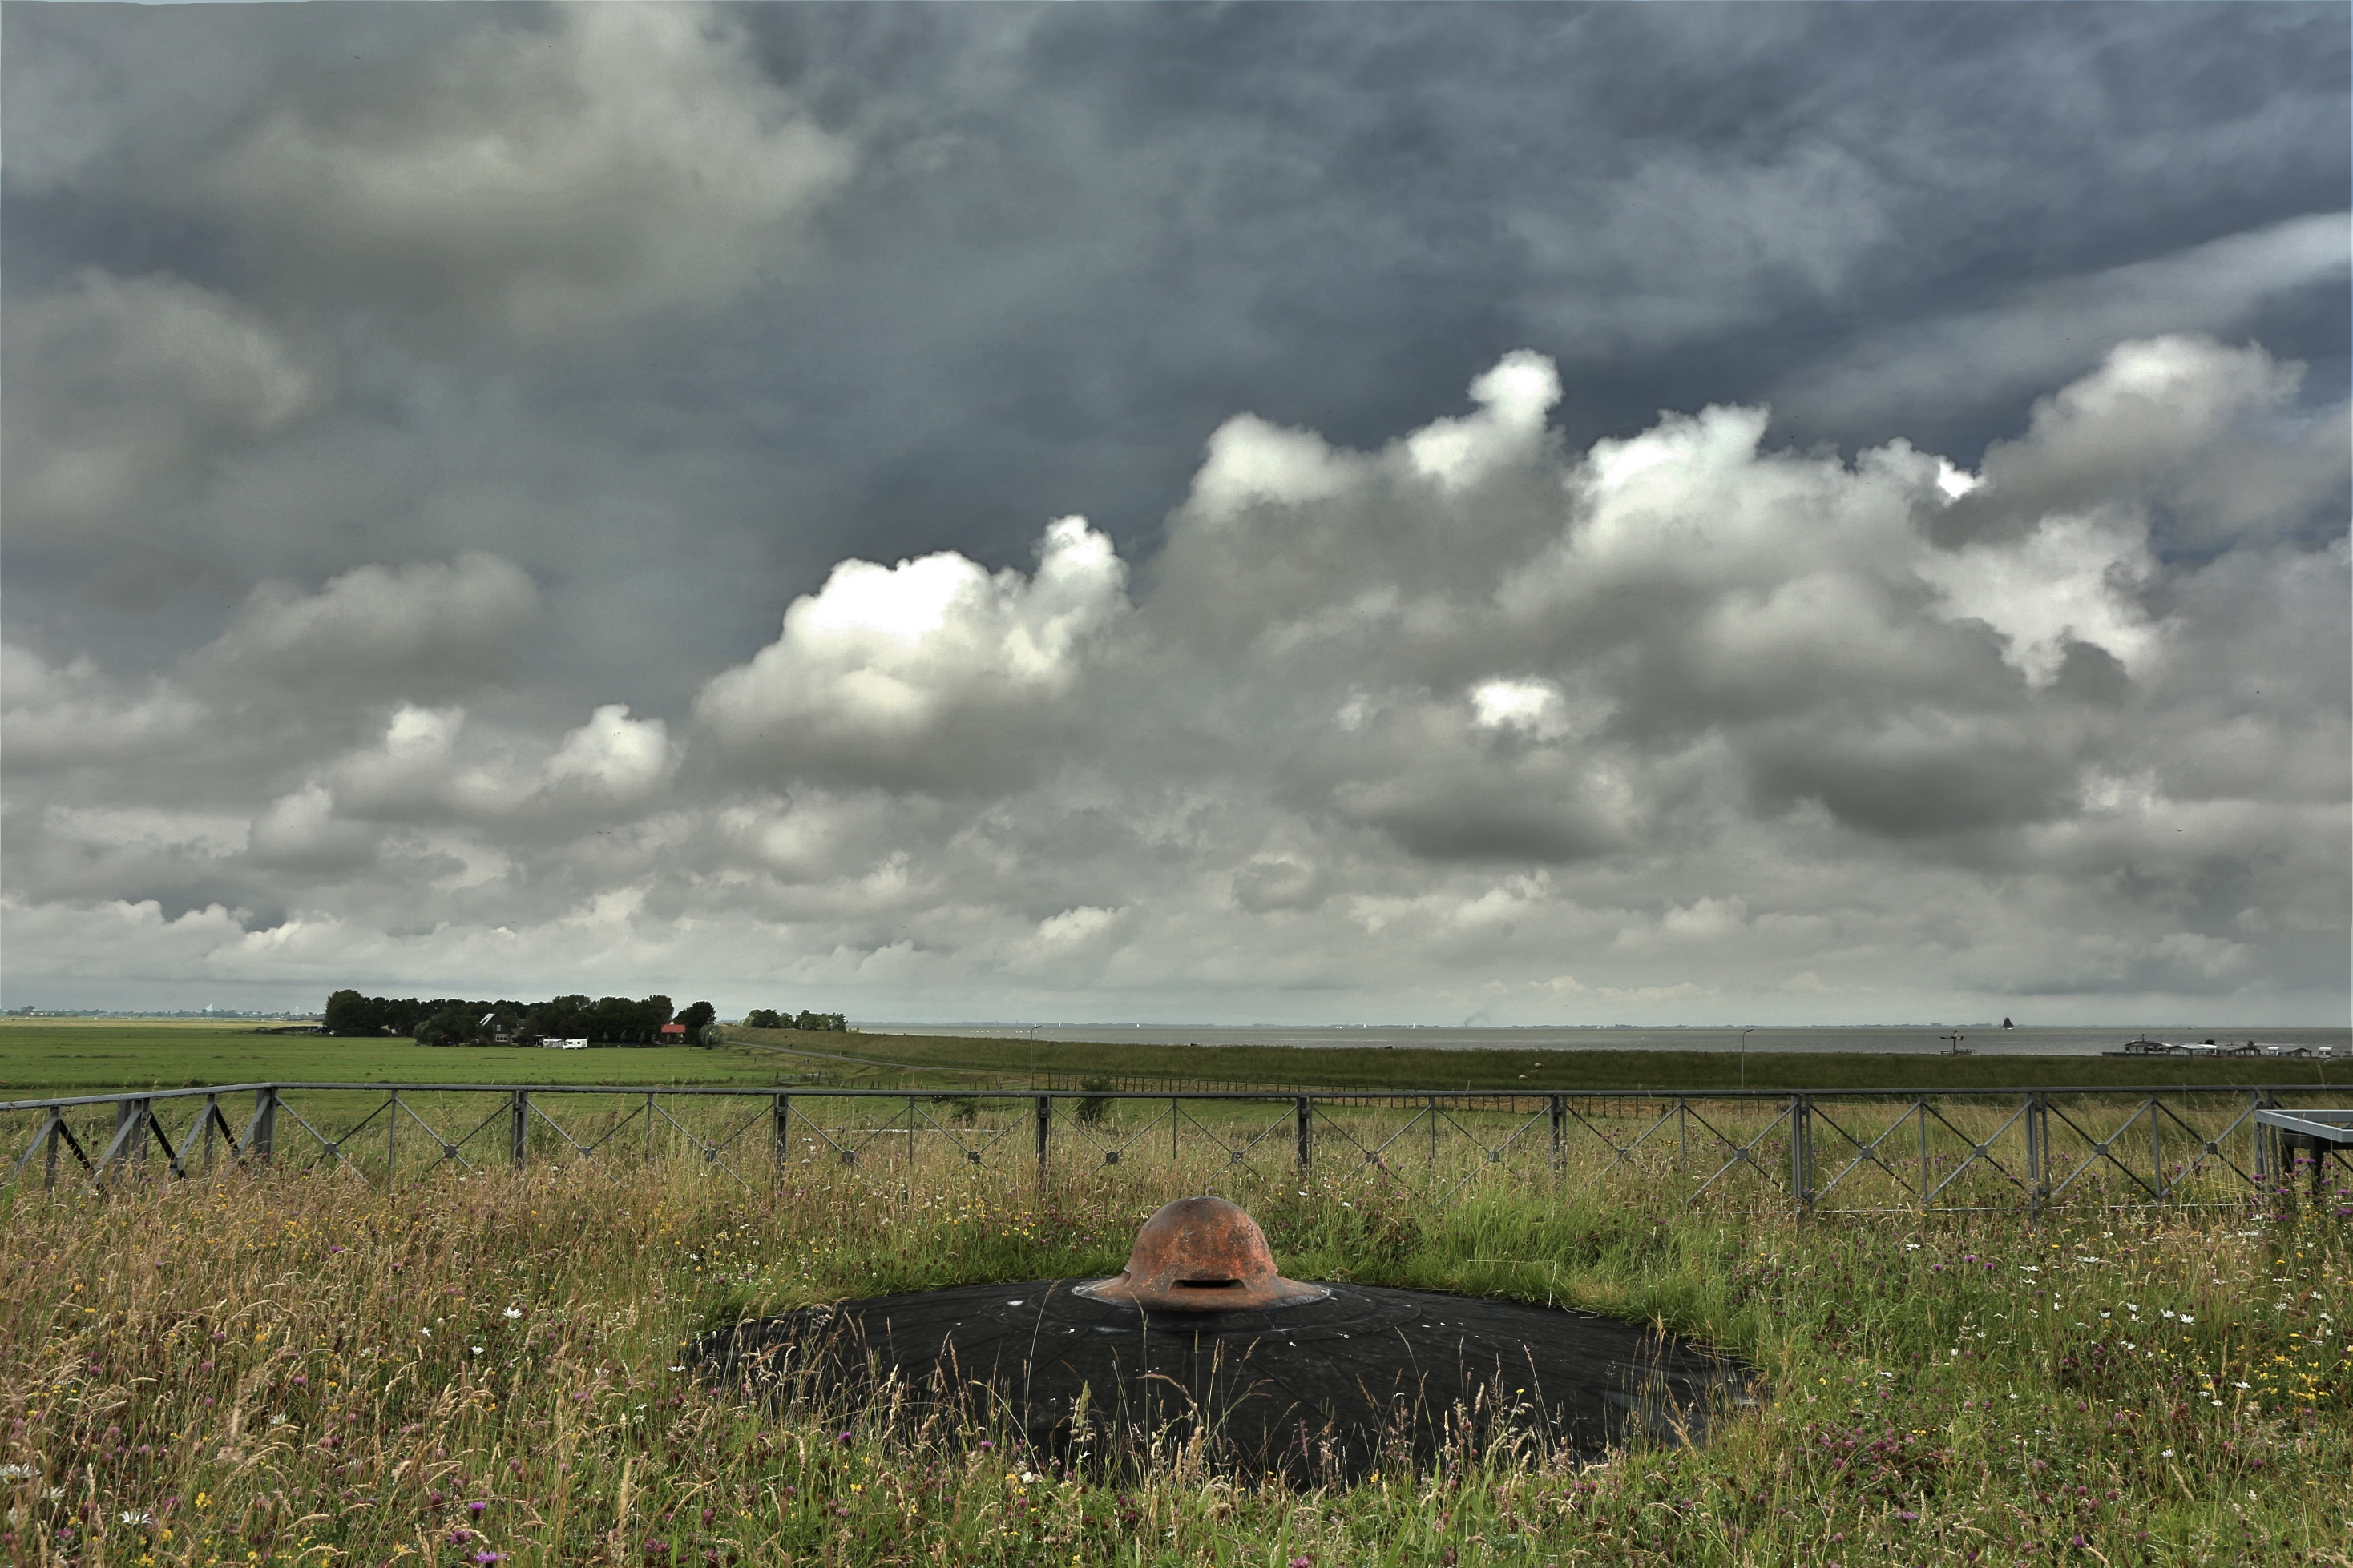
1874
1914

Slide 6
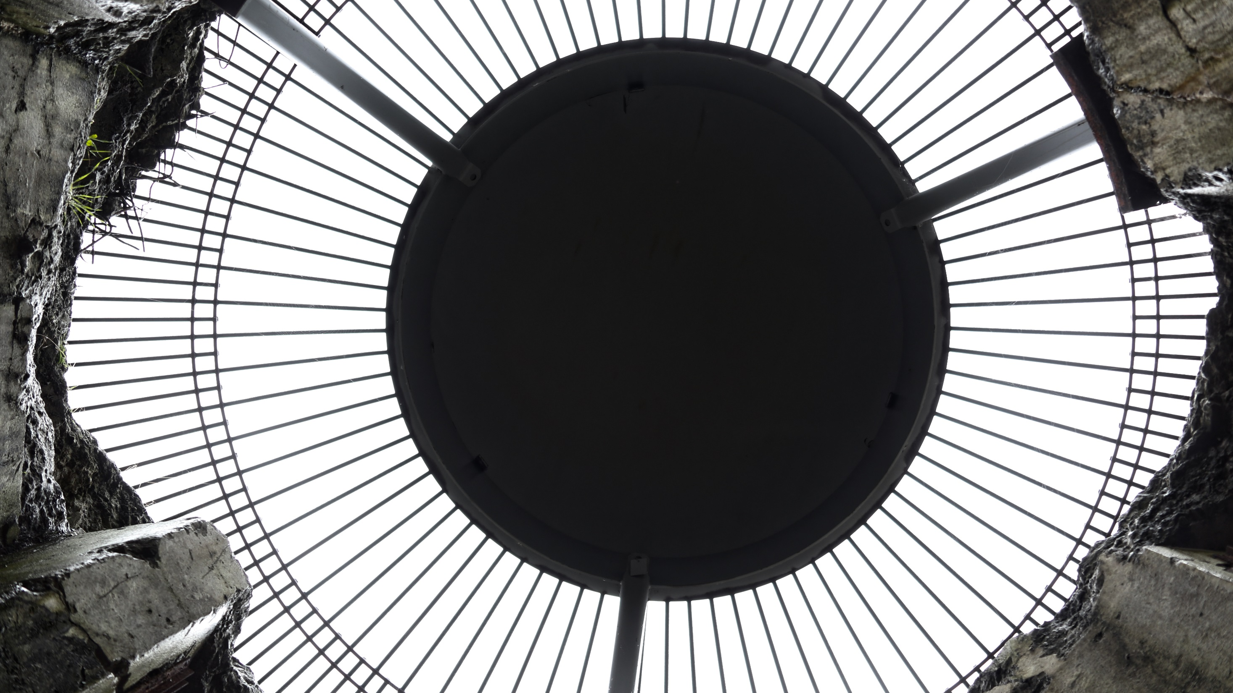

Slide 7
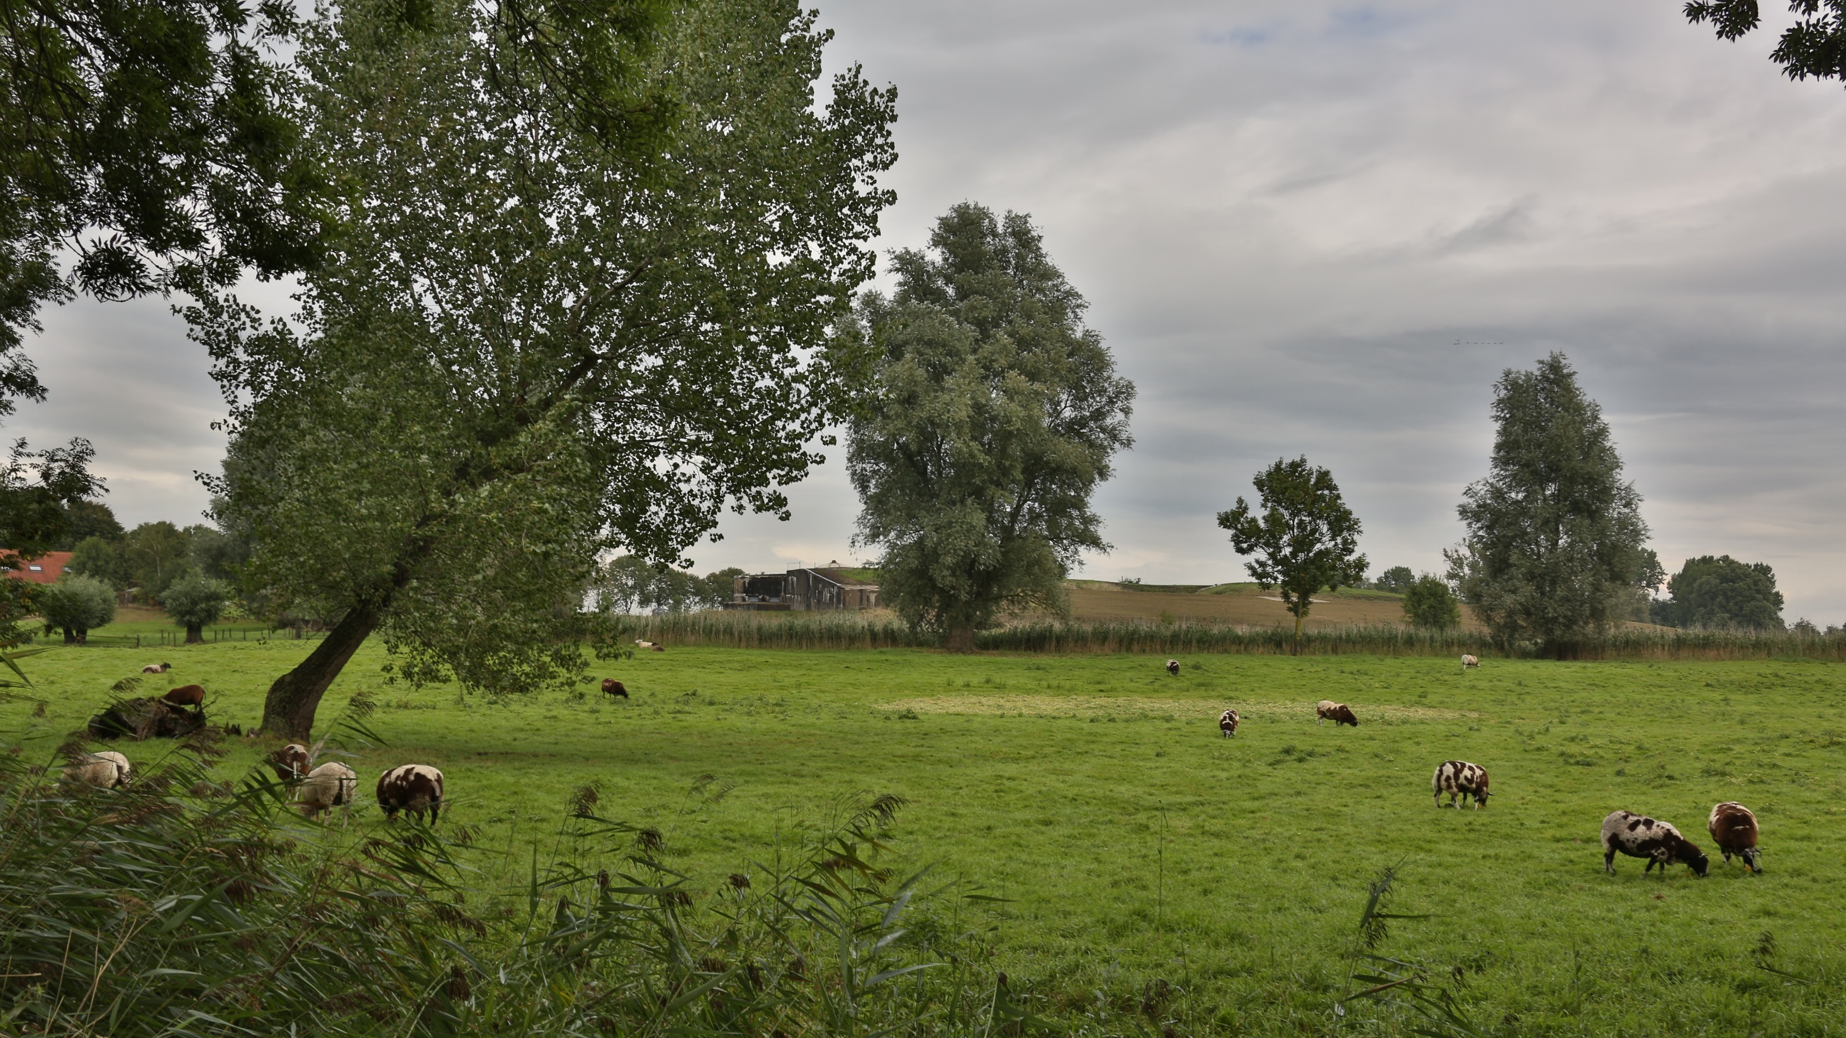

Slide 8
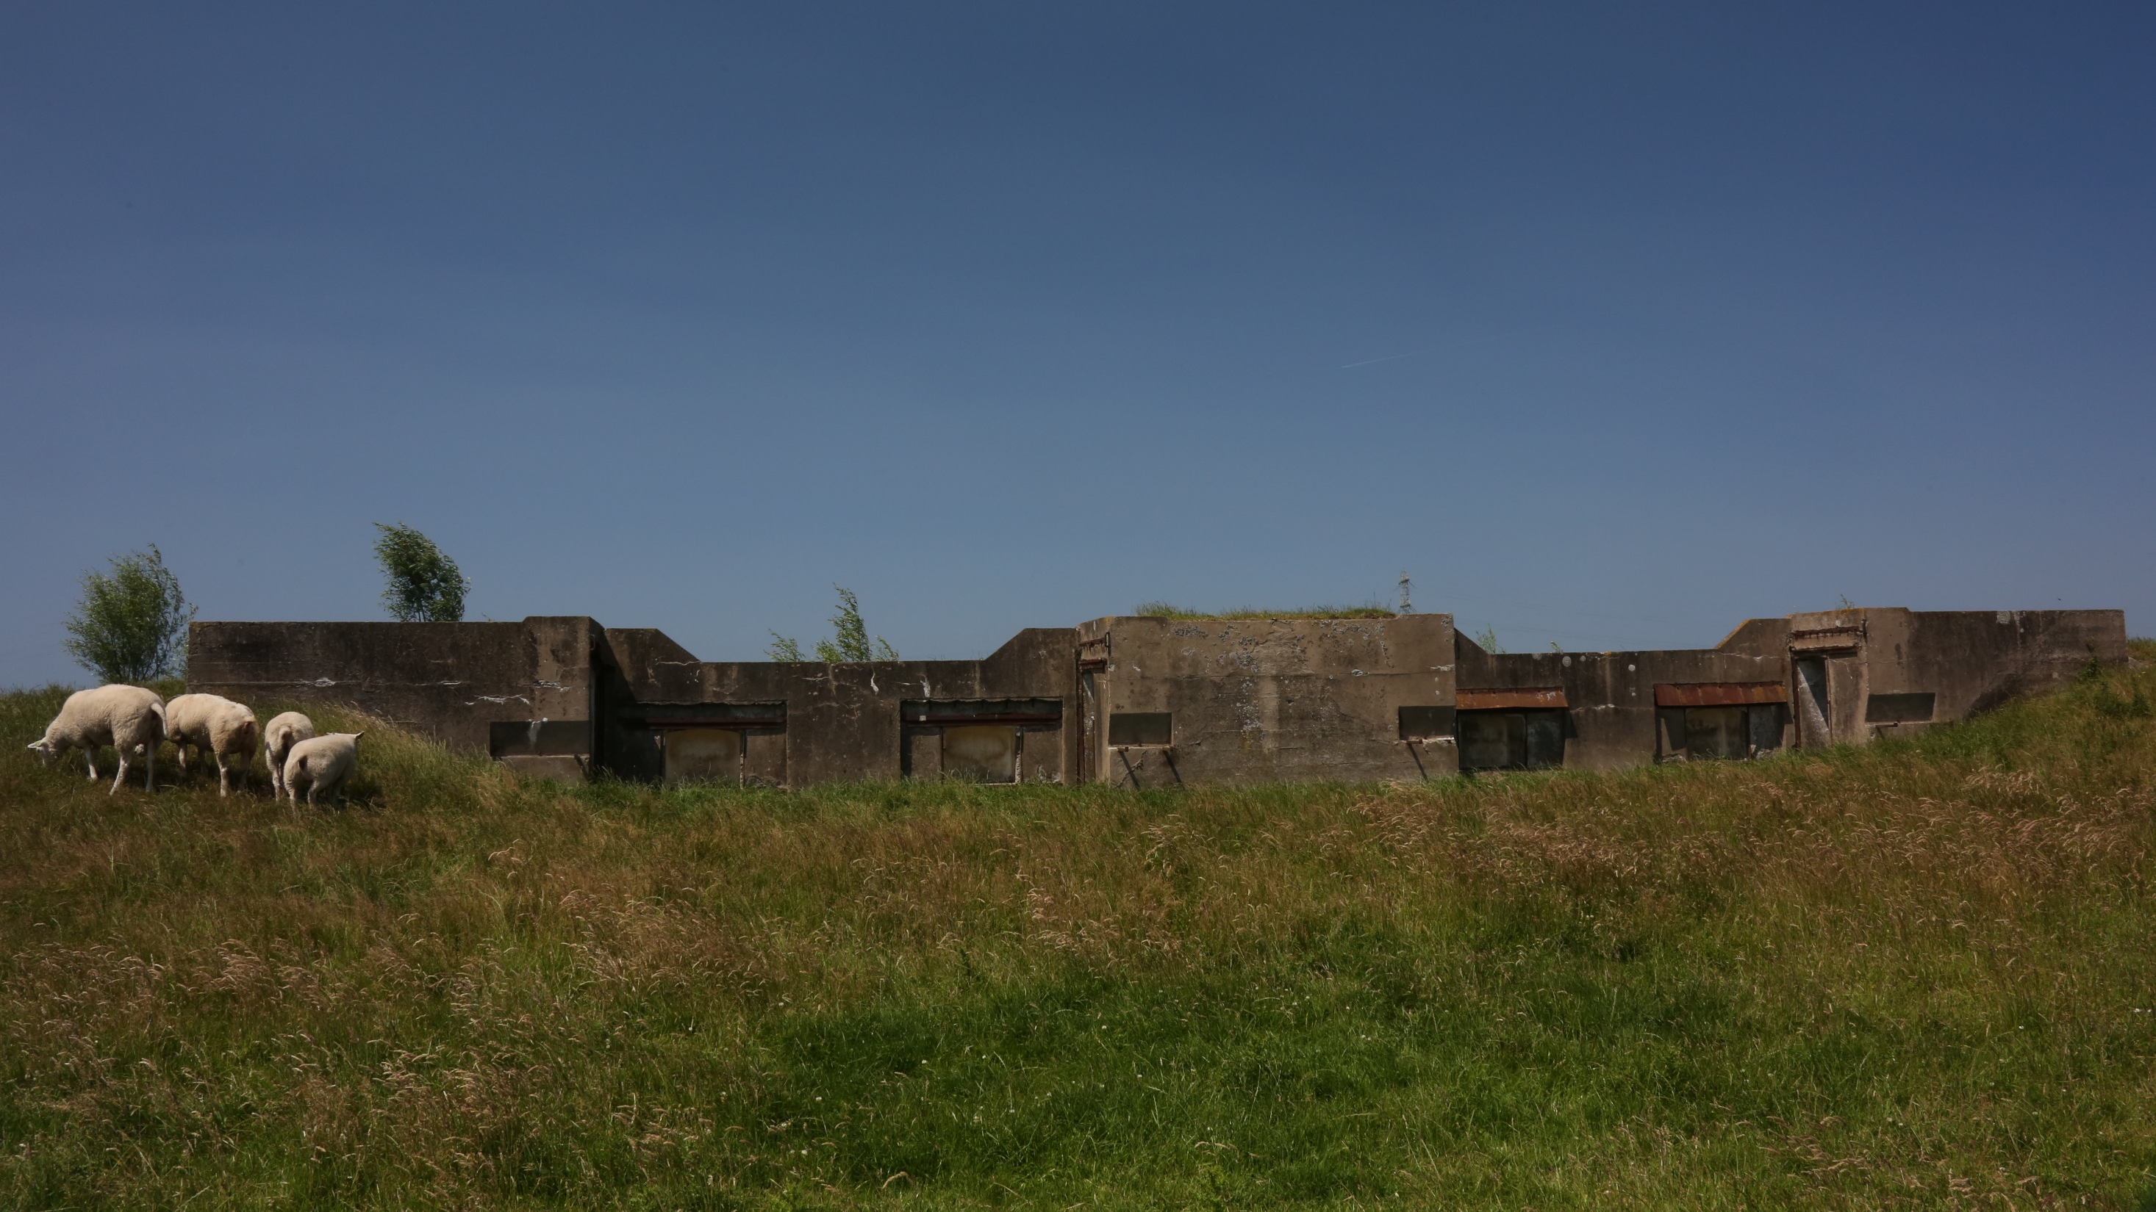

Slide 9
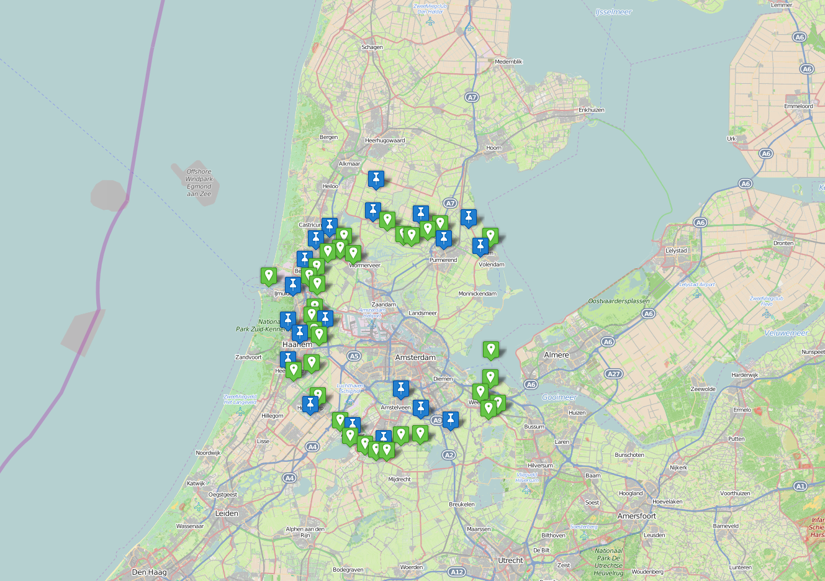
One-time protected the Defensive Lines of Amsterdam residents against human enemy’s
By upgrading the old Defensive Lines with our special Plant concepts we are ready for our new enemy……..

Slide 11
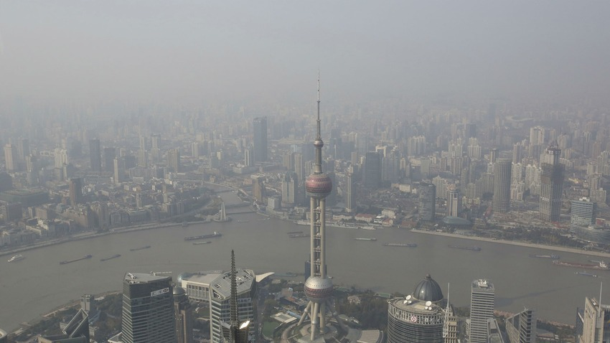
Metropolitan cities with enormous SMOG problems

Slide 12
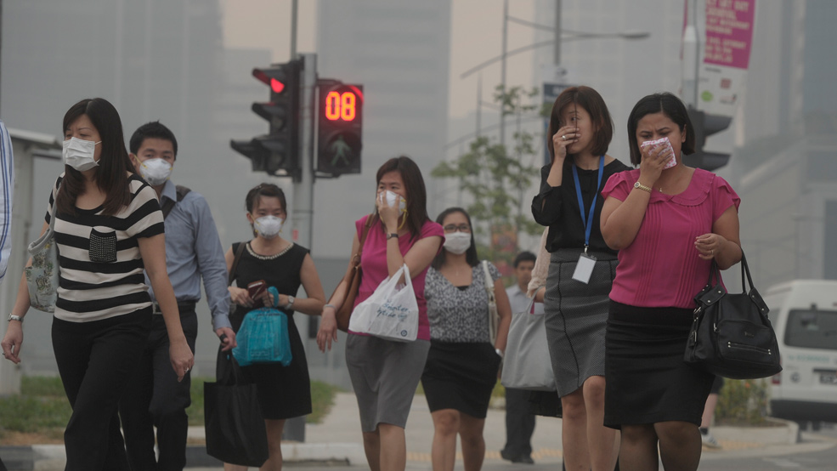
If we do nothing, this is our future Worldwide……..

Slide 13
Our new enemy….
Collective &
Participation
Started at 2015

Slide 14
The Dutch Solution:
PLANTS of the Future

Slide 15
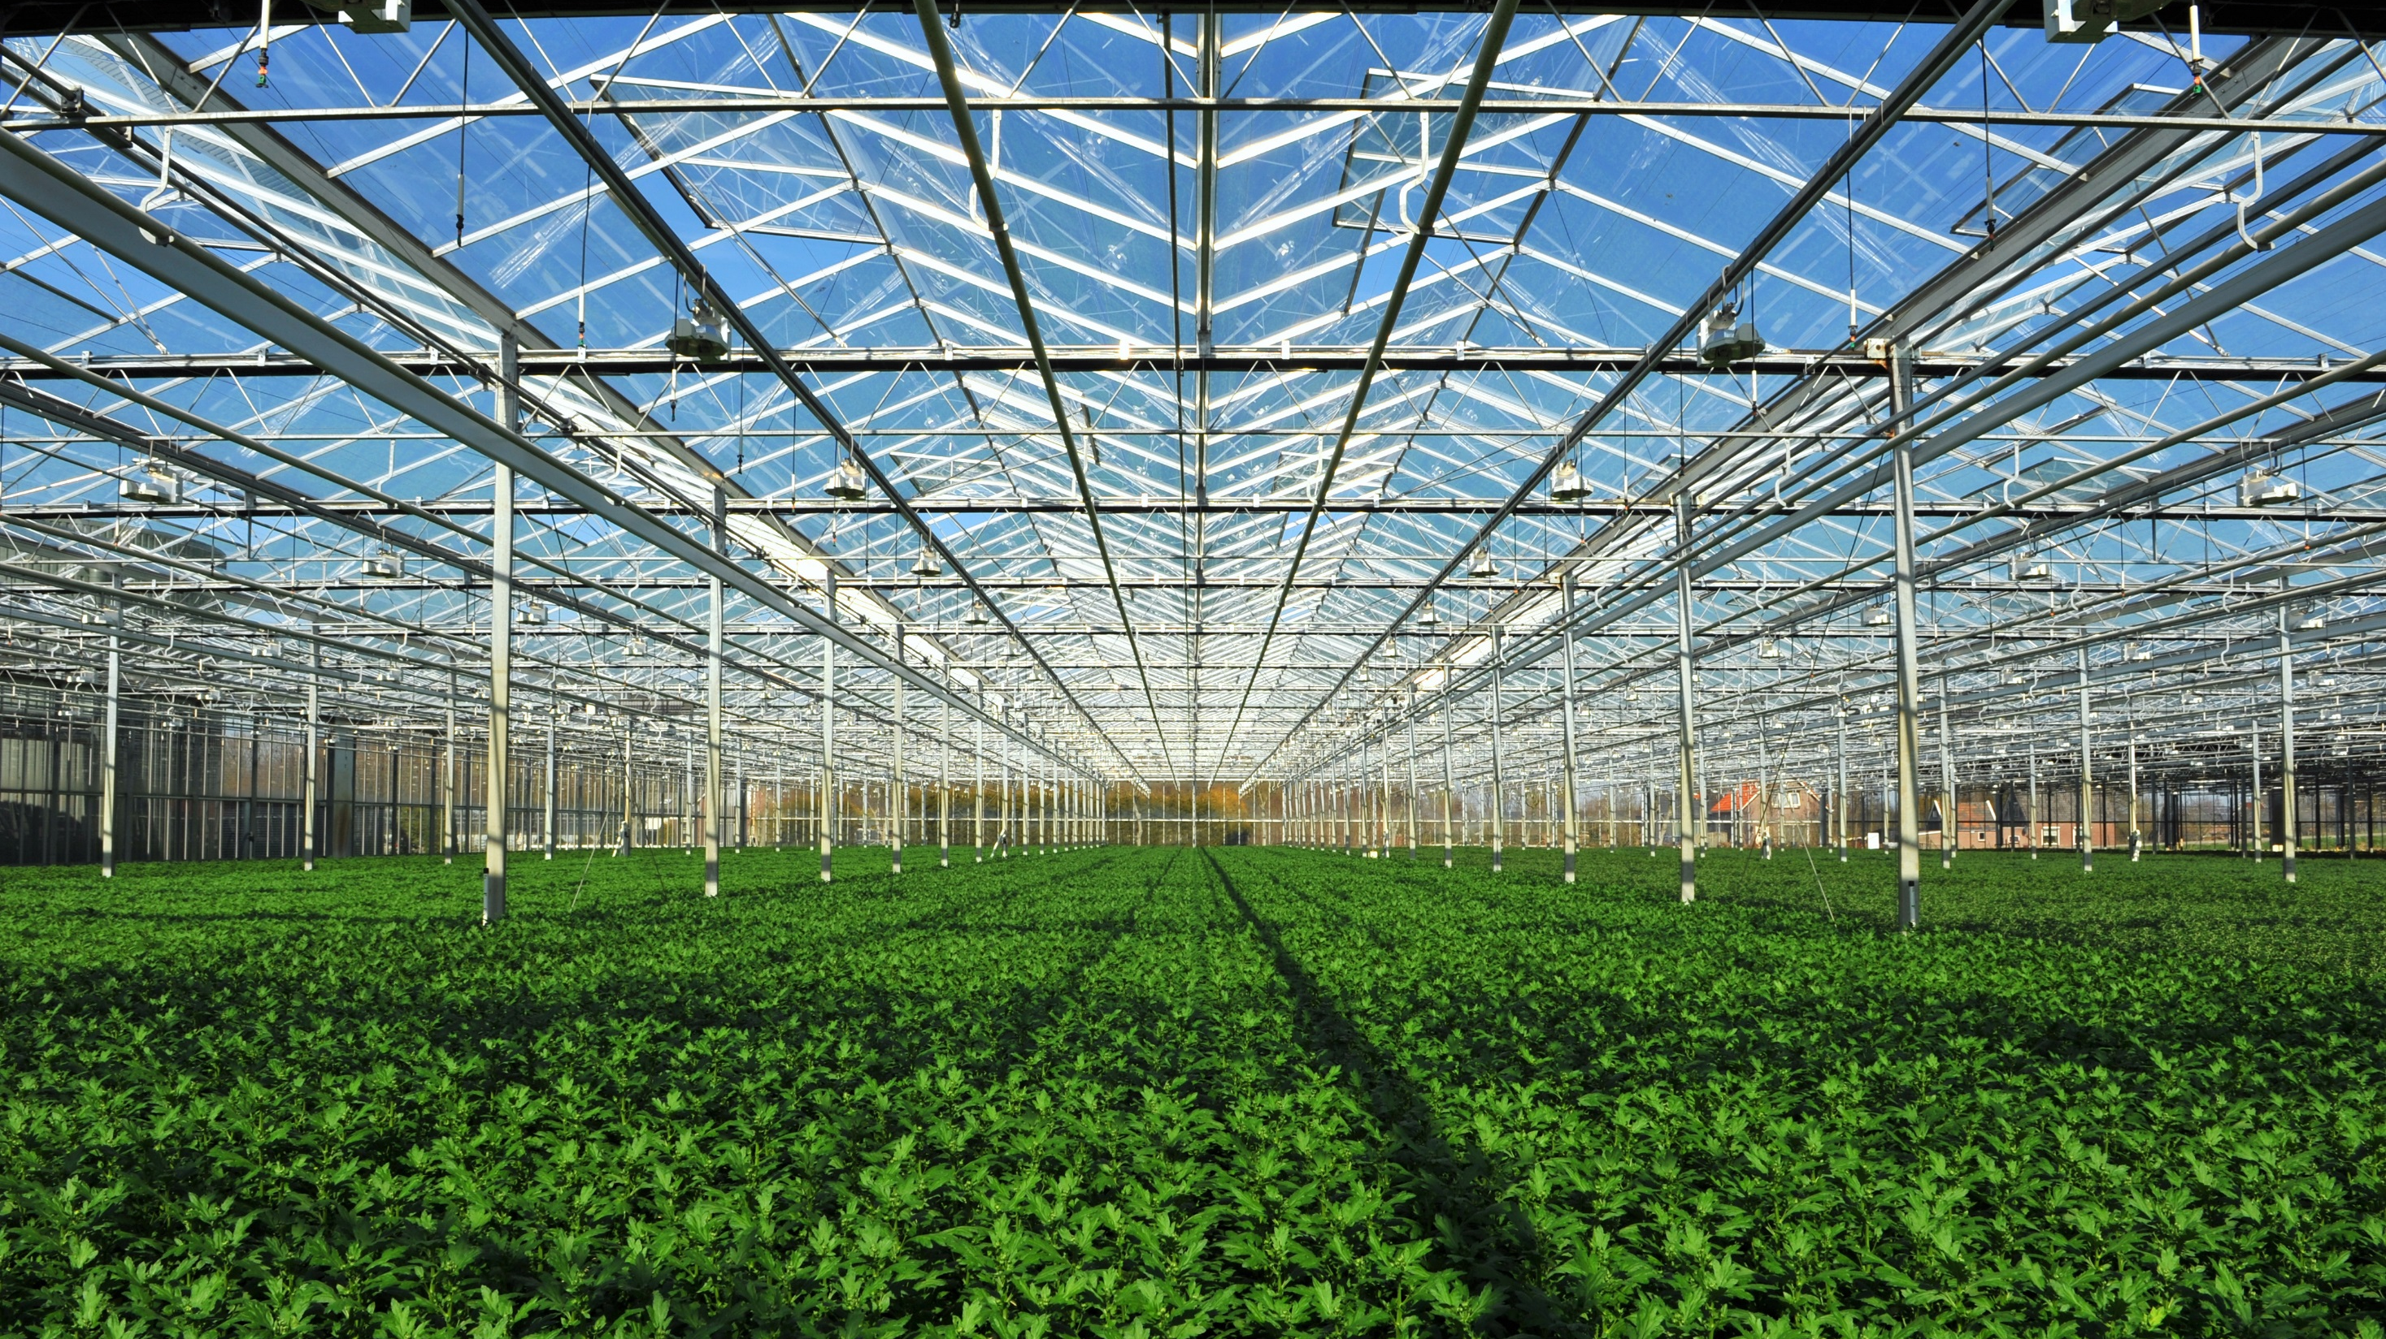
Our first GREENHOUSE
is filled with special plants

Slide 16
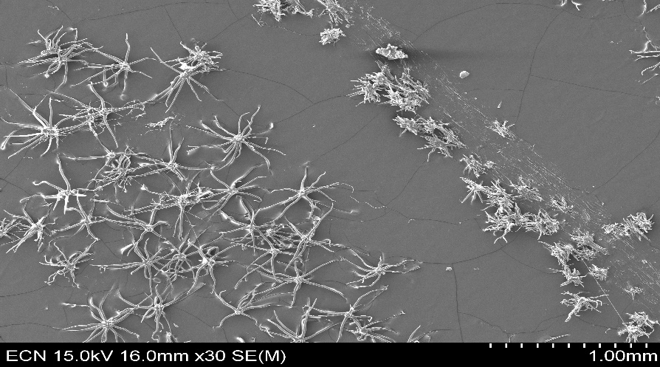
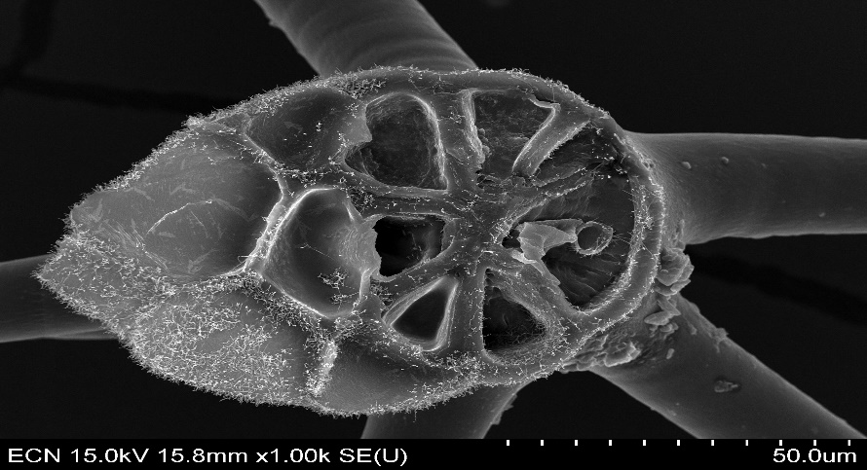
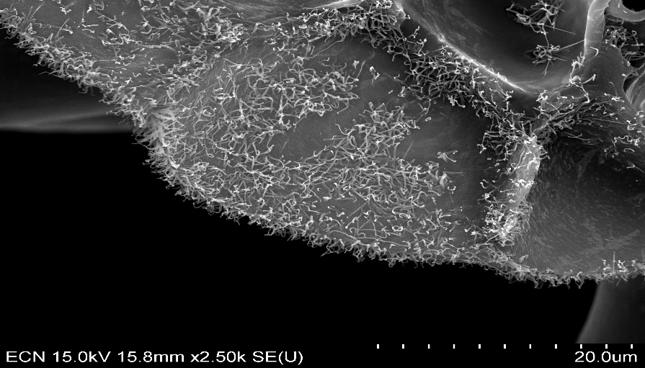
Specially cultivated plants have leaves with a lot of hair
These leaves capture CO2
and the hairs capture a lot of small dust

Slide 17
Specially cultivated native plants with
new growth properties for the future
TEST AREA: BENELUXBAAN
Regular plants
Specially cultivated plants

Slide 18
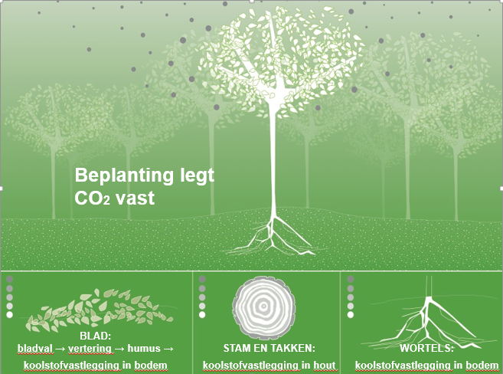

Slide 19
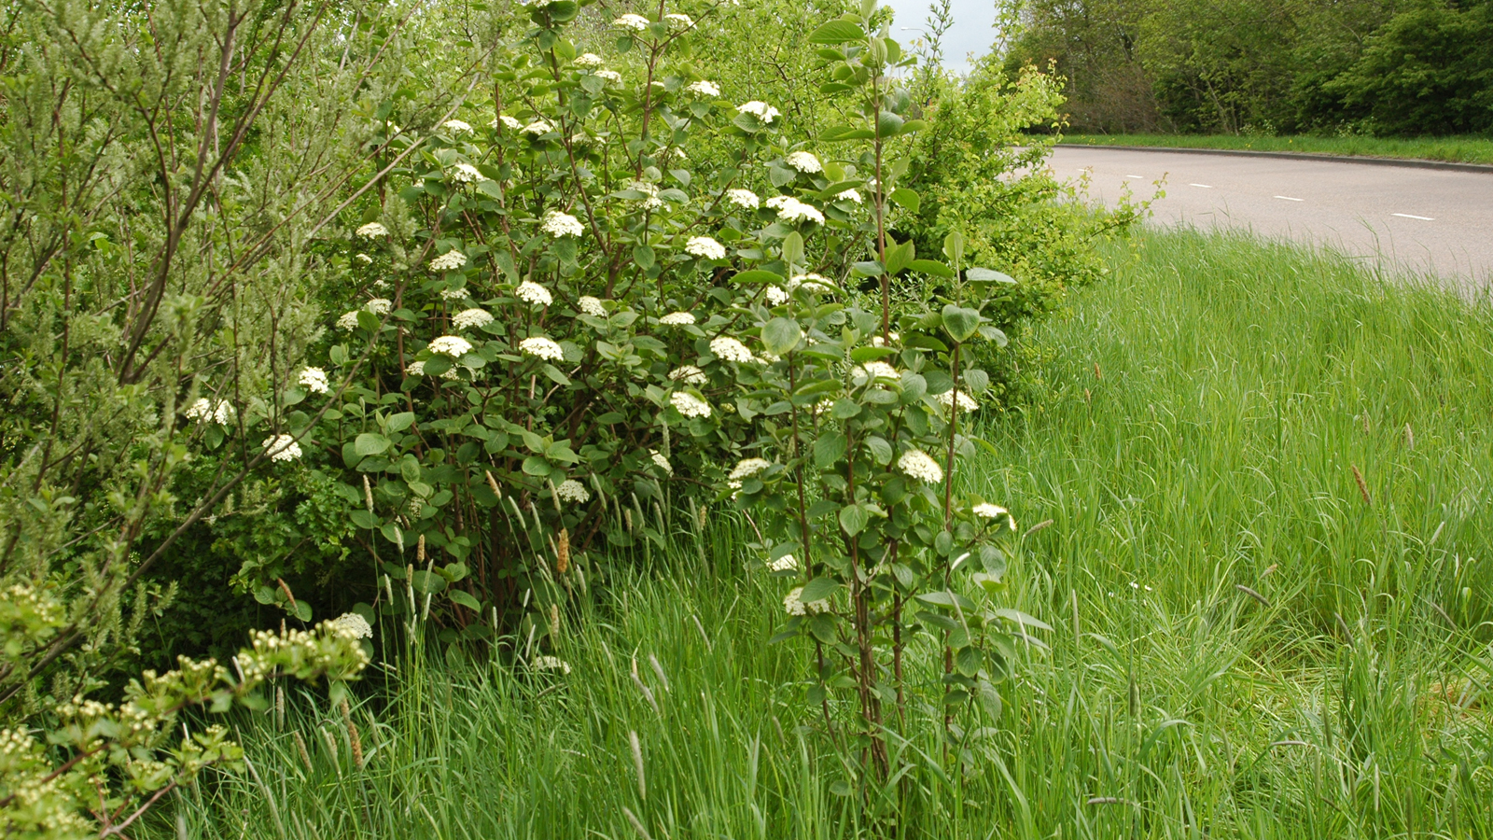
The special plants GROWS three times
faster then regular plants….

Slide 20
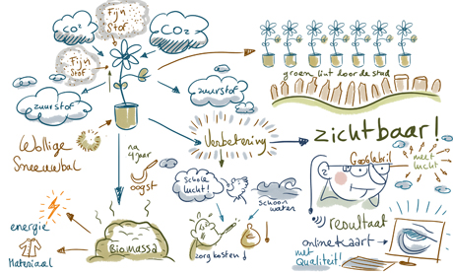

Slide 21
Specially cultivated plants
principles
applied with special developed CONCEPTS

Slide 22
DE STELLING 2.0
possible available projects:

Slide 23
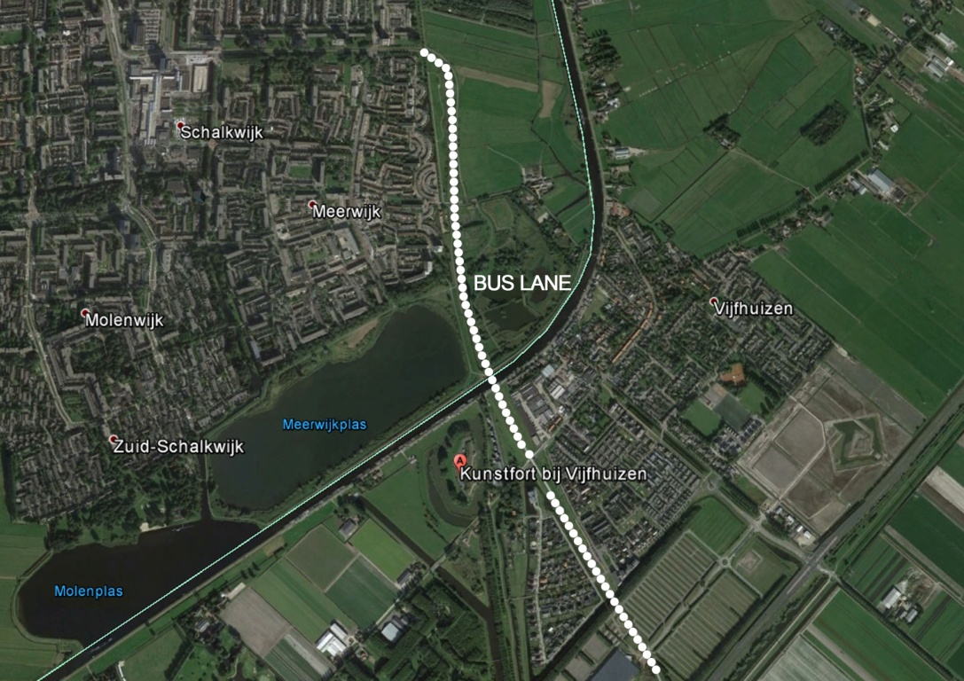
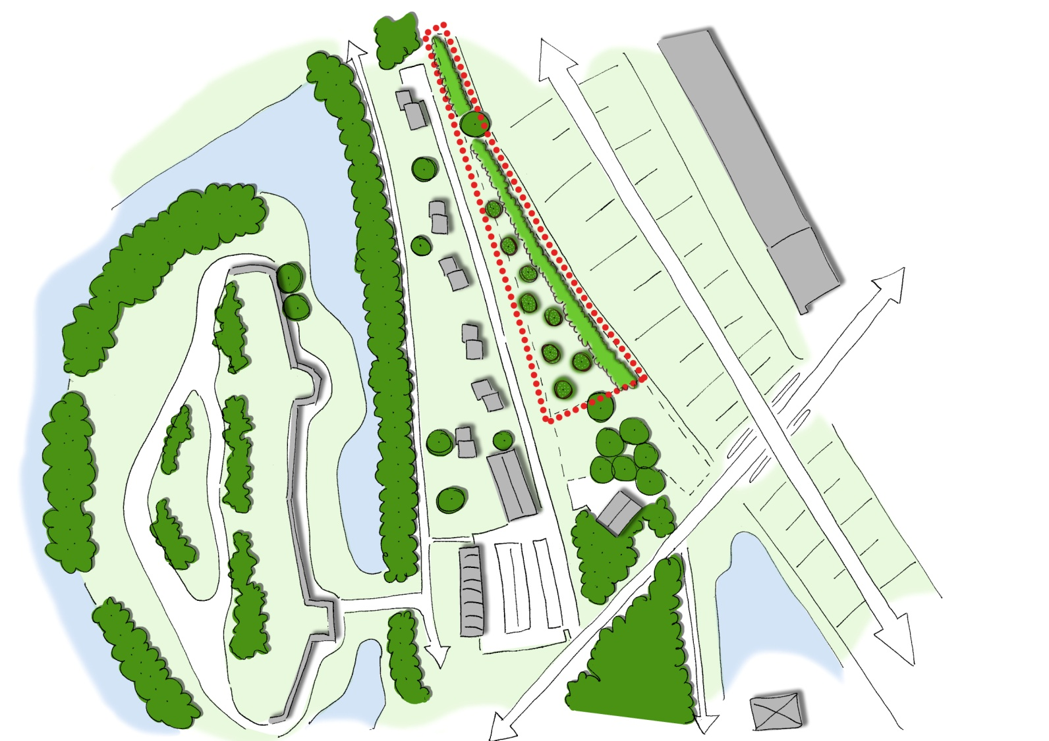
Project: Fort Vijfhuizen
Between Schiphol, Hoofddorp and Haarlem
Located along a bus route
Advertising opportunities

Slide 24
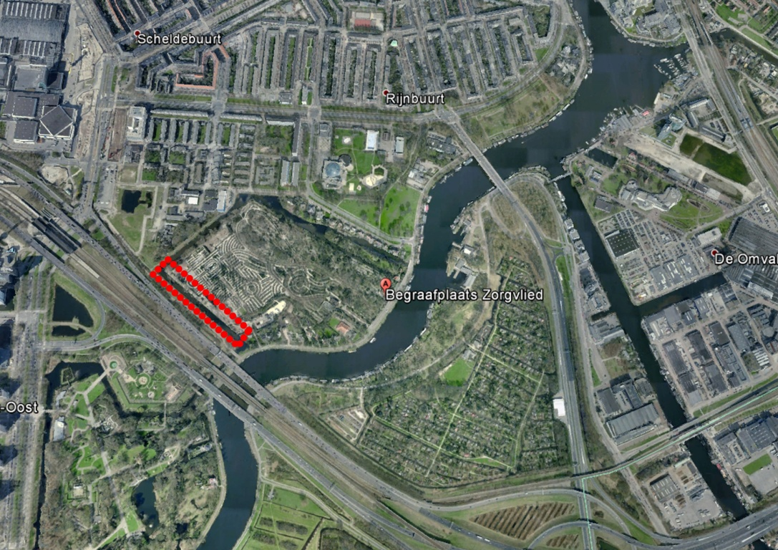
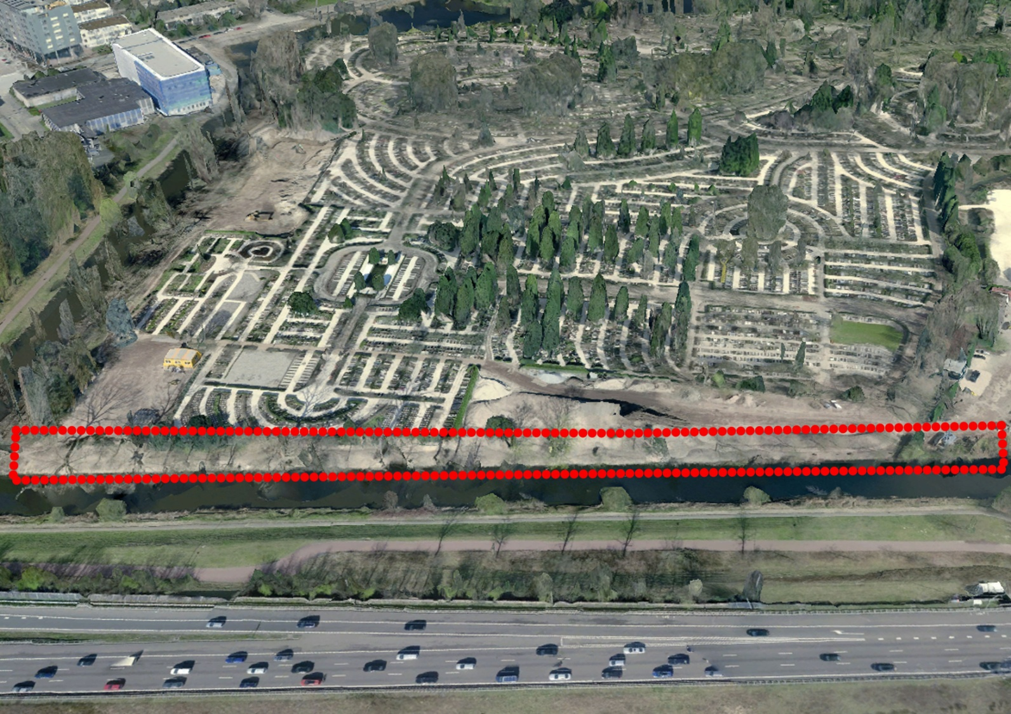
Project: Cemetery Zorgvlied
Cemetery Zorgvlied Amsterdam, along the A10
Replant shore along A10
Advertising opportunities

Slide 25
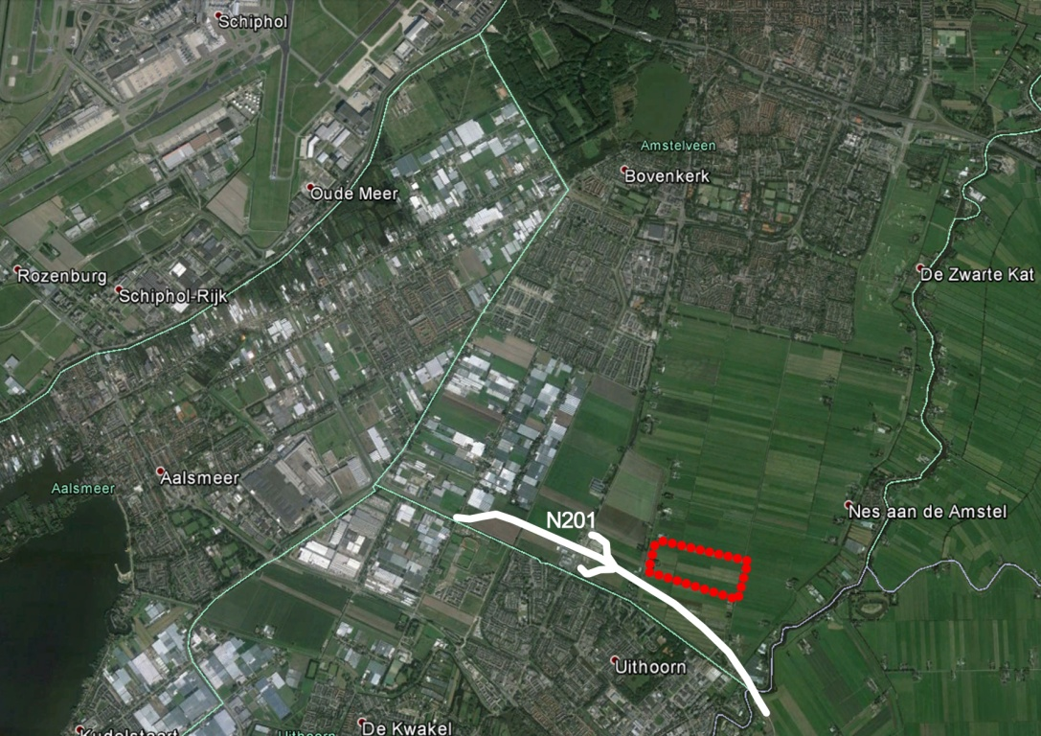
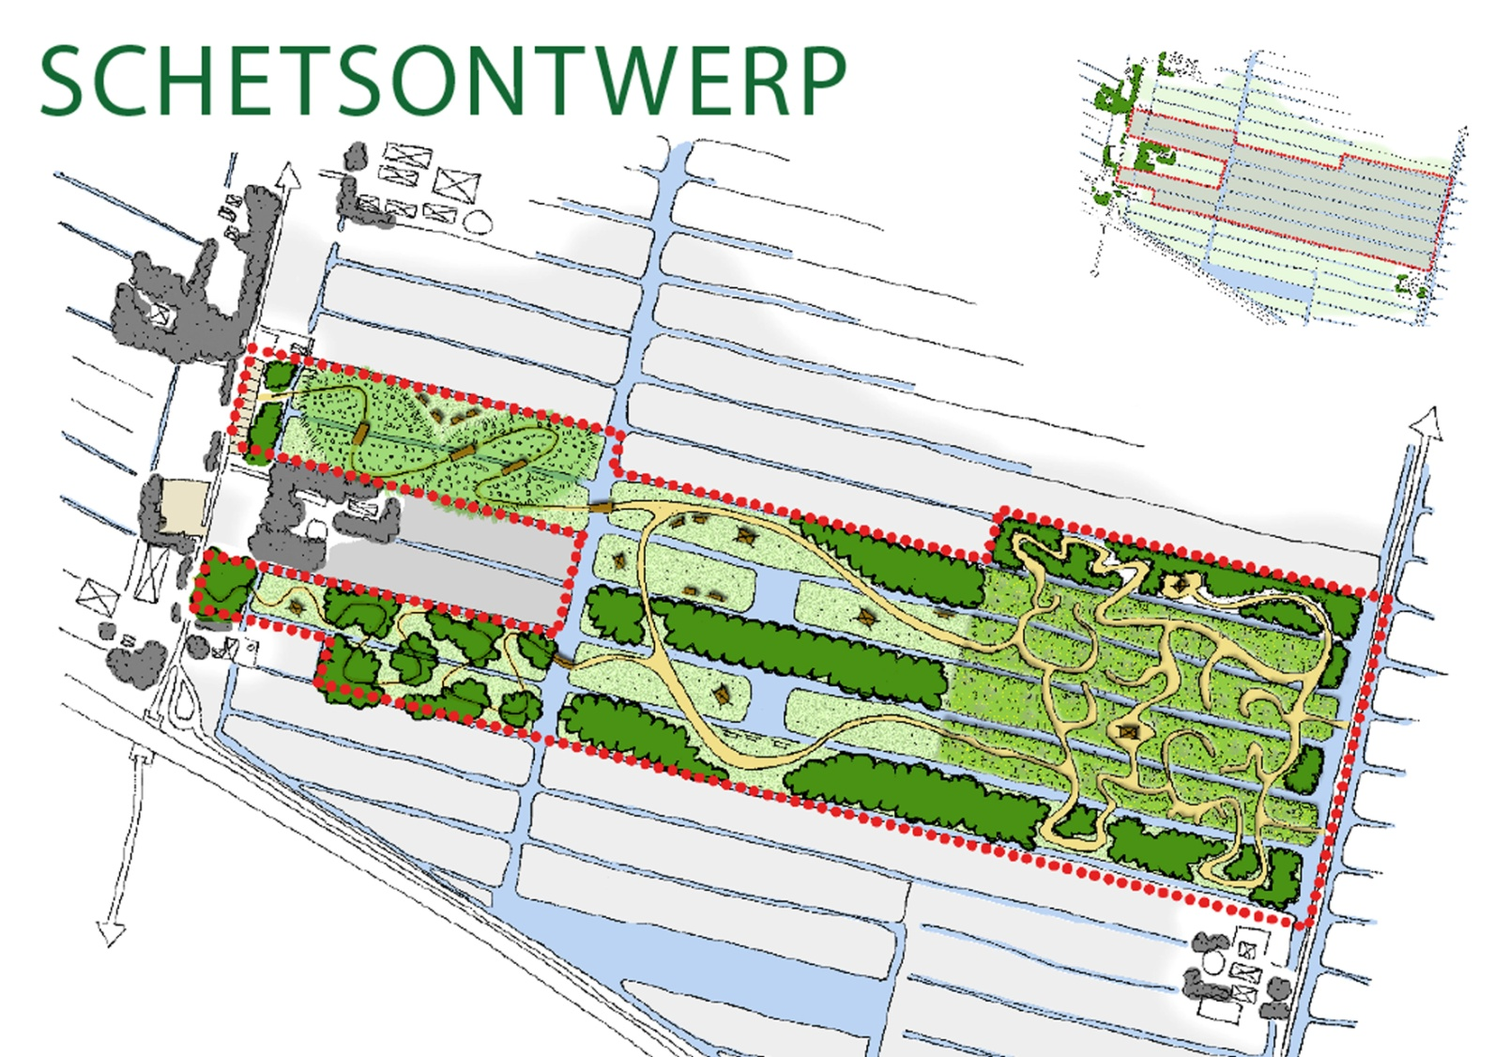
Project: N201
Landscape park new to develop, along the N201
Advertising opportunities

Slide 26
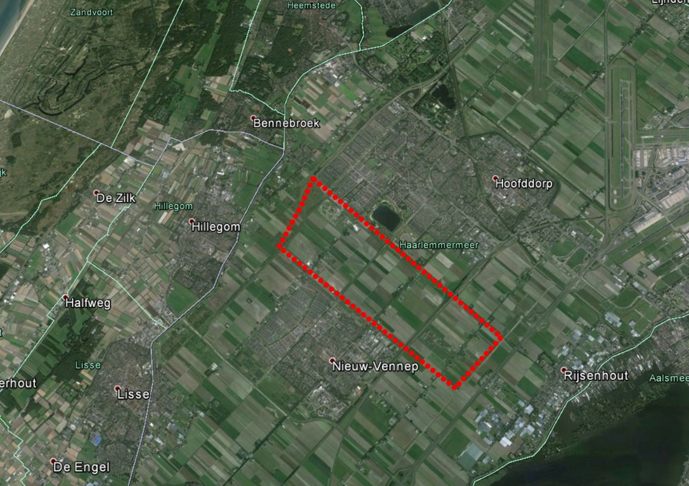
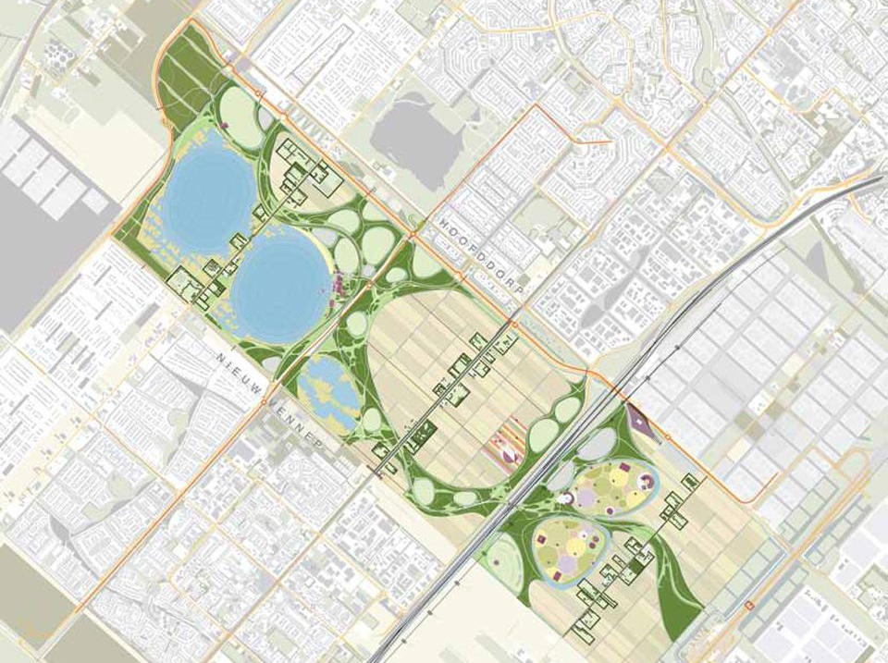
Project Park 21, Haarlemmermeer
Landscape park new to develop, along the A4
Between Nieuw-Vennep, Hoofddorp and Rijsenhout
Advertising opportunities

Slide 27
Specially cultivated plants
summarized

Slide 28
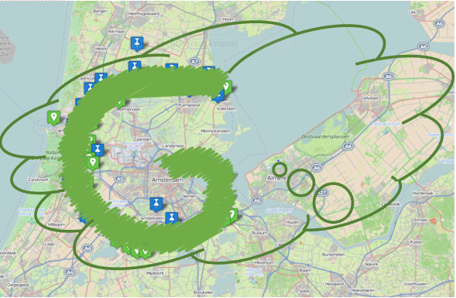
Overarching collective project
the innovative way to a healthy metropolis
Greenport Aalsmeer – Wageningen-UR-PPO
Noord Holland, Stelling van Amsterdam
Ministerie Economische Zaken RVO
Flevoland, Floriade Almere 2022
Lelystad, NSE-iCHALLENGE
RWS, SAA-traject
Overige 36 MRA-partners
25.000 hectares = 100 m2 /person

